Slide 1
Open-Source Machine Learning Platforms

Slide 2
Introduction to Open-Source ML Platforms
Open-source ML platforms provide flexibility, scalability, and cost efficiency.
Customizable to specific organizational needs, supporting workflows across teams.
Avoids vendor lock-in, enabling integration with diverse tools.
Popular open-source tools include Kubeflow, MLflow, Airflow, Seldon Core, and Feast.
Widely adopted for their broad support, community contributions, and cost savings.

Slide 3
Core Components of an ML Platform
Data Science Environment: Provides workspaces (e.g., Jupyter) for data analysis, experimentation, and model building.
Model Training Environment: Dedicated infrastructure for large-scale, complex model training tasks.
Model Registry: Centralized repository for tracking and managing models, ensuring proper versioning and lifecycle management.
Model Serving Environment: Hosts models to serve predictions, providing API access for client applications.
ML Pipeline Development: Automates and orchestrates ML workflows, like data preparation, model training, and deployment.

Slide 4
Additional Core Components
Model Monitoring: Tracks deployed model performance (e.g., accuracy, data drift) to maintain quality over time.
Feature Management: Central repository for managing commonly used features across ML projects, improving consistency.
CI/CD and Workflow Automation: Automates the ML lifecycle for efficient, reliable, and consistent deployments.
Security and Governance: Ensures role-based access, data management policies, and compliance with regulatory standards.

Slide 5
Open-Source Technologies for ML Platforms
Common open-source tools include Kubeflow, MLflow, Seldon Core, Feast, and Airflow.
Advantages: Flexibility, cost savings, large support communities, and no licensing fees.
Challenges: Complex integration, security concerns, and additional maintenance efforts.
Organizations need to balance flexibility and technical requirements before adopting.

Slide 6
Kubeflow for Data Science
Kubeflow is a comprehensive ML platform built on Kubernetes, supporting ML workflows at scale.
Jupyter Notebooks enable data scientists to explore data and build models interactively.
Training Operators: Distributed training support for handling large datasets and complex models.
Model Serving: KFServing integrates for real-time predictions and batch processing.

Slide 7
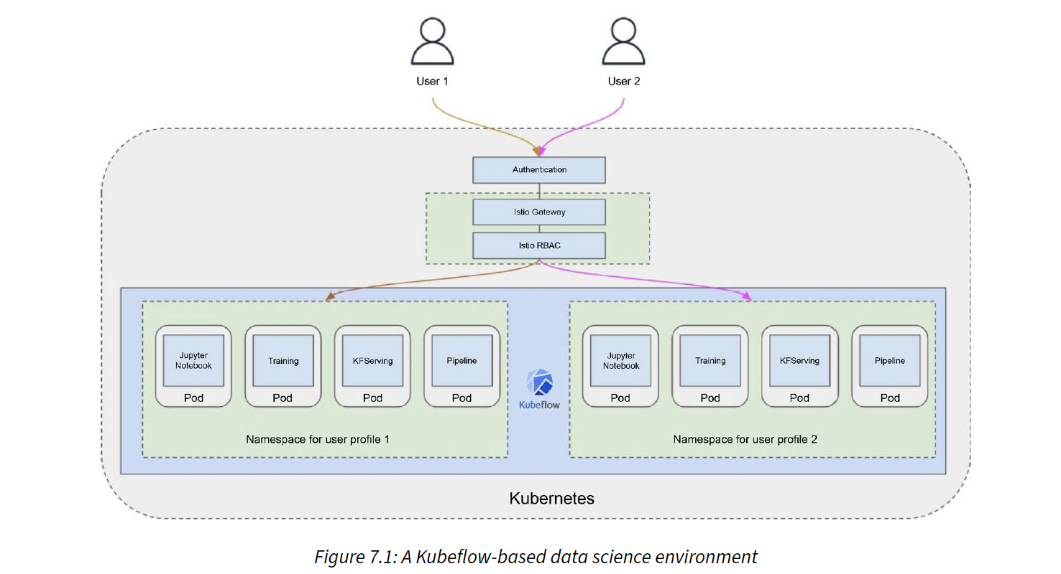
Kubeflow environment

Slide 8
Key Kubeflow Features
Authentication/Authorization: Uses Dex and Istio for identity management and in-cluster access control.
Multi-Tenancy: Allows multiple users to share resources securely in isolated namespaces.
Enables team collaboration with options to share notebooks and resources.
Administrators can create standard images for consistent, repeatable environments.

Slide 9
Challenges in Kubeflow
Complex Installation: Deployment on Kubernetes requires high configuration and troubleshooting skills.
Version Compatibility: Ensuring all components (e.g., Jupyter, KFServing) are compatible adds complexity.
Documentation Gaps: Limited support documentation for newer versions can increase setup time.
Despite challenges, Kubeflow is popular for its robust support across the ML lifecycle.

Slide 10
Training with Kubernetes Jobs
Kubernetes Jobs: Runs containers for ML training and completes tasks, ideal for single training jobs.
Configuring YAML Files: Define resource requirements, dependencies, and retry policies in job YAML files.
Monitoring: Use kubectl logs to check job status and training progress.
Benefits: Greater control over resources and process management, adaptable for different ML models.

Slide 11
Training with Kubeflow Training Operators
Training Operators: Supports distributed, large-scale training for ML frameworks (e.g., TensorFlow, PyTorch).
Custom Resources: Define worker, master nodes, and resource allocations in YAML for complex jobs.
High Control: Manages training environment, job state, and fault tolerance.
Ideal for models that need distributed processing, like deep learning with large datasets.

Slide 12
MLflow Model Registry Overview
Experiment Tracking: Logs parameters, metrics, and code versions to ensure traceability of experiments.
ML Projects: Packages code for easy reproduction and deployment across platforms.
Model Registry: Tracks model versions, annotations, stages (e.g., staging, production) for organized deployment.
Model Packaging: Standardizes models for seamless deployment across cloud providers (e.g., AWS, Azure).

Slide 13
MLflow Architecture
Architecture Overview: Central tracking server maintains model history and details.
Integrates with Docker, SageMaker, and Azure ML for deployment compatibility.
UI and API Support: Interactive UI for tracking experiments and API for programmatic access.
Basic authentication for security, but lacks advanced features for larger organizations.

Slide 14
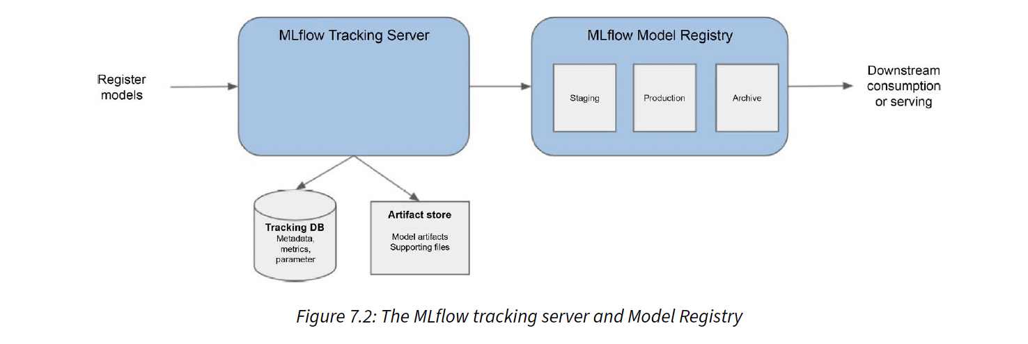
MLflow tracking server and Model Registry

Slide 15
Serving Models with Flask/Gunicorn
Flask Framework: Lightweight and easy to set up for model prediction endpoints.
Gunicorn Web Server: Manages multiple requests simultaneously, improving scalability.
Nginx as Load Balancer: Adds SSL/TLS termination and load balancing for handling larger traffic volumes.
Suitable for simpler use cases with minimal concurrency and performance needs.

Slide 16
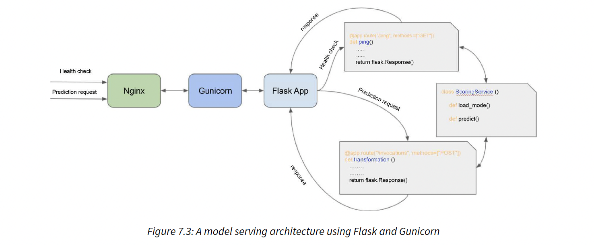
Flask/Gunicorn Model Serving

Slide 17
TensorFlow Serving
Production-grade serving for TensorFlow models, enabling stable and scalable model predictions.
Supports Versioning: Allows multiple versions of models to run behind the same endpoint.
Canary Deployments: Roll out new model versions gradually to manage risk.
Optimized for high-throughput, low-latency inference tasks, both real-time and batch.

Slide 18
TorchServe
Open-source, production-ready serving for PyTorch models, with REST API support.
Built-in Features: Multi-model serving, request batching, and version control.
Monitoring Support: Logs and tracks model performance metrics to support model management.
No need to write custom code for serving, simplifies production use for PyTorch models.

Slide 19
KFServing and Seldon Core
KFServing: Versatile, multi-framework serving solution for diverse ML models.
Seldon Core: Advanced features like A/B testing, traffic routing, and inference graphs.
Uses backends like TensorFlow Serving, TorchServe to deploy models with flexible configurations.
Ideal for large organizations needing flexibility in serving multiple ML models across frameworks.

Slide 20
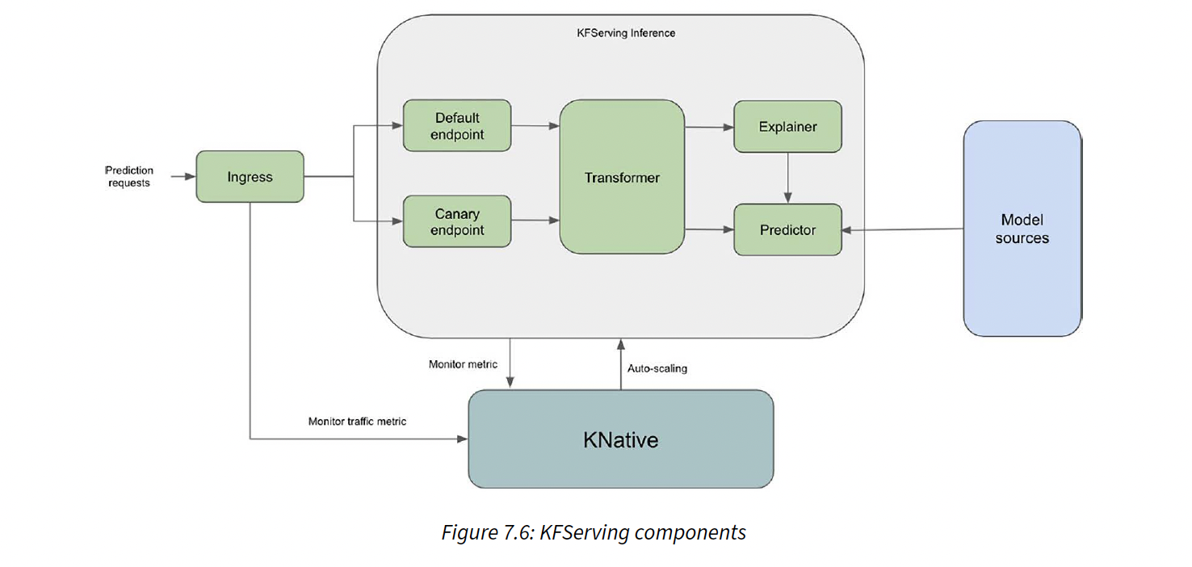
KFS Serving

Slide 21
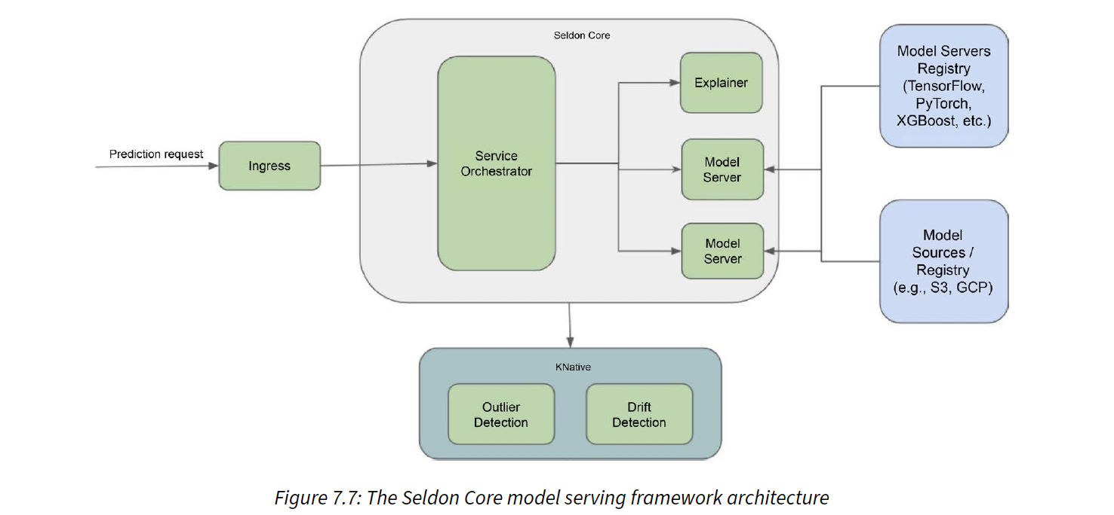
Seldon Core

Slide 22
Monitoring Models in Production
Data Drift Detection: Identifies when incoming data distributions differ from training data.
Model Drift Detection: Monitors for decreased performance due to changing data patterns.
Popular Tools: Evidently AI, Arize AI, and Seldon Core offer comprehensive monitoring solutions.
Continuous monitoring enables preemptive actions to prevent performance degradation.

Slide 23
Managing ML Features with Feast Feature Store
Feature Store: Central repository that provides fast access to frequently used features.
Consistency Across Projects: Features stored once and reused across models for consistency.
Feature Versioning: Tracks changes to features over time, improving experiment reproducibility.
Compatible with frameworks like TensorFlow and PyTorch, integrates well with ML workflows.

Slide 24
Apache Airflow for Workflow Automation
DAG (Directed Acyclic Graph): Defines the flow and dependencies of ML tasks.
Tasks and Operators: Tasks perform the work, while operators define task behavior.
Scheduling: Set DAGs to run at regular intervals or based on custom schedules.
Sensors: Wait for specific events (e.g., file arrival) to trigger downstream tasks.

Slide 25
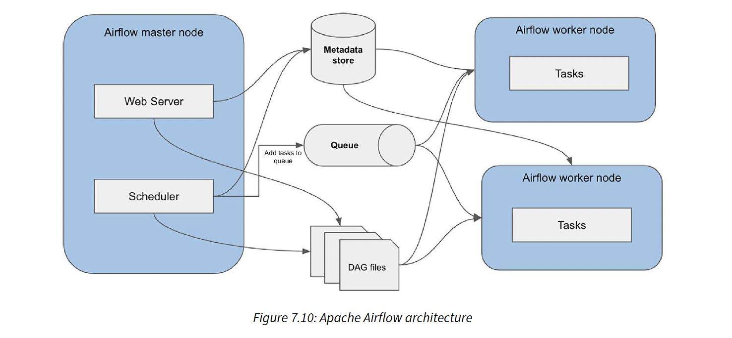
Apache Airflow architecture

Slide 26
Kubeflow Pipelines
Pipeline Definition: Each ML workflow is a sequence of pipeline components.
Pipeline Components: Reusable tasks such as data preprocessing, training, and evaluation.
Run Triggers: Allows for scheduled or manual execution of pipelines.
Visual UI for pipeline monitoring and results visualization, ideal for ML experimentation.

Slide 27
Kubeflow-Based ML Platform (Architecture)
Kubeflow as Base: Leverages Kubeflow Jupyter Notebook, training operators, and KFServing.
MLflow Integration: Tracks experiments, manages model registry for lifecycle management.
GitHub and Docker Hub: Code and Docker images stored for easy access and reproducibility.
Flexible for end-to-end ML workflows from data exploration to production deployment.

Slide 28
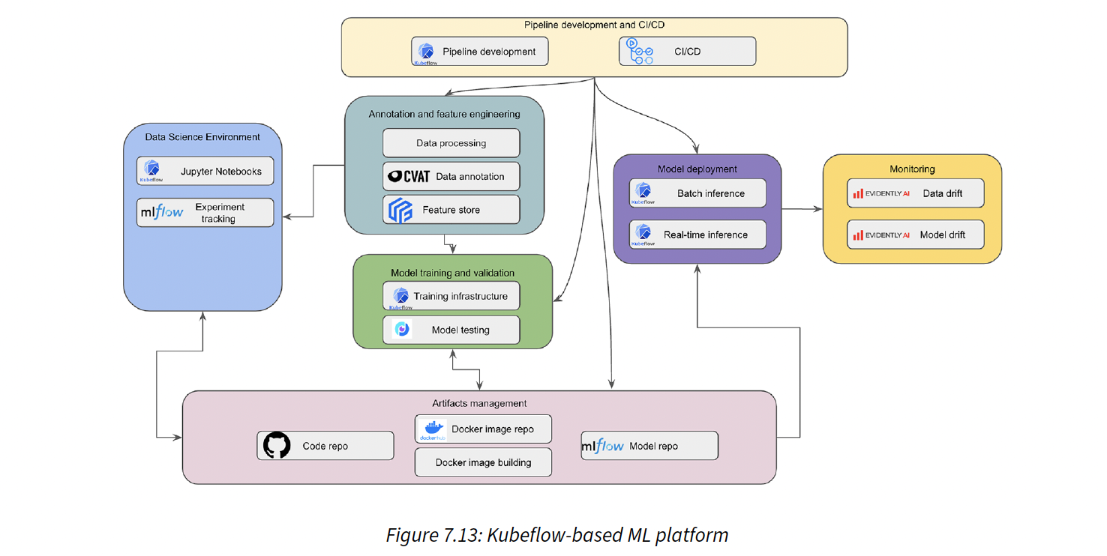
Kubeflow-based ML Platform

Slide 29
Component-Based ML Platform (Alternative Approach)
Uses individual tools (e.g., Airflow, GitHub, Kubernetes) instead of a single ML framework.
Airflow for Orchestration: Manages dependencies and schedules across ML pipelines.
Kubernetes for Infrastructure: Customizes training and serving infrastructure as needed.
Allows selection of best-in-class components to fit unique organizational needs.

Slide 30
Summary
Open-source ML platforms provide essential tools for end-to-end ML workflows.
Core components include data science, training, registry, serving, and pipelines.
Kubeflow, MLflow, Airflow, and Seldon Core are popular choices for ML environments.
Effective feature management and model monitoring are crucial for maintaining accuracy.

